Slide 1

Credit Card Fraud Detection by Machine Learning
The Data Incubator Project
Yuxuan Xin 2018.02.22

Slide 2


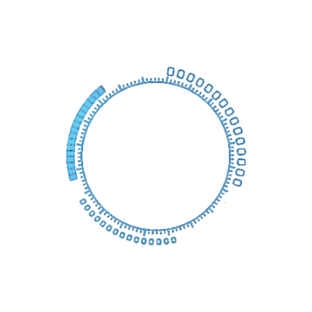



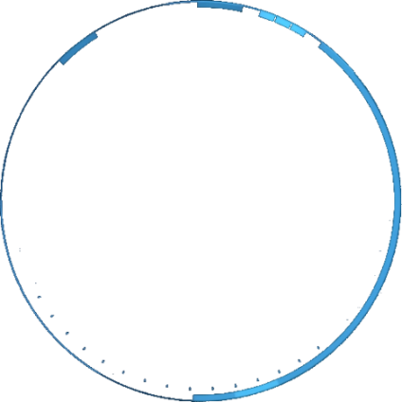
Motivation
Methodology
Outline
Statistic Approach
Supervised Learning
Summary & Future Work

Slide 3
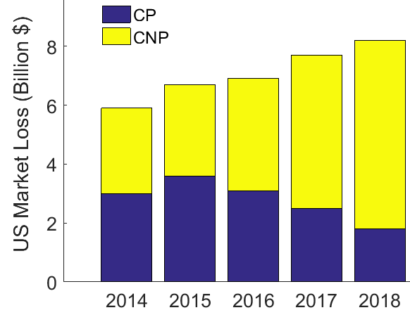
Motivation
Credit Card Fraud
unauthorized use of a credit card to steal money
Huge Financial Loss
US customer pays 7.7 billion $ in 2017
2 Type Fraud
Card-Present (CP): physically present card
Card-Not-Present (CP): internet & telephone
EMV Smart Chip Implement in 2015
Cut CP fraud by 50% in 2018 (projected)
CNP fraud rises by 110% in 2018 (projected)
Machine Learning
apply to identify fraud efficiently & accurately
US Market
Credit Card Fraud
Financial Loss (Billion $)

Slide 4
Data Set
Source
Offered by Kaggle
Transactions by European cardholders (2013.09)
Size
300K transactions
113 MB in cvs format
Content
Time & amount
28 PCA variables
Class 0/1
Highly Unbalanced
0.2% fraud scenario

Slide 5
Methodology
Statistic Approach
Outlier detection
Chauvenet's criterion
Grubbs' test
Supervised Learning
0/1 Classification problem
Logistic Regression
Neural Network
Random Forest
Evaluation
Highly unbalanced sample
Confusion Matrix
Actual | Predicted
 | Positive | Negative
Positive | True Positive | False Negative
Negative | False Positive | True Negative
Accuracy: (TP+TN)/Total
Recall: TP/(TP+FN)
Specificity: TN/(TN+FP)
Precision: TP/(TP+FP)
Type I Error: FP/(FP+TP)
Type II Error: FN/(FN+TN)
F1 Score:
2/(1/recall+1/precision)

Slide 6
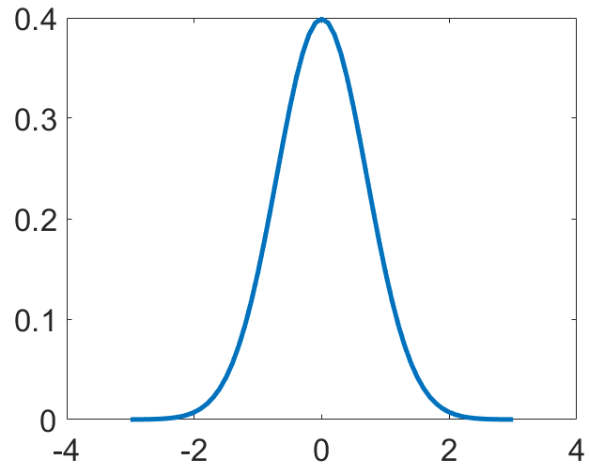
Statistic Approach
Chauvenet's Criterion
Multi-dimension Normal Distribution
Calculate Mean, covariance matrix from
class 0 samples
Calculate probability of class 1 samples
existing in class 0 distribution
Identify most effective threshold (p-value) to classify class 0/1 samples by trial-error
 | TN | FN | TP | FP
Challenge | 277043 | 86 | 406 | 7272
Current | 284060 | 230 | 262 | 255
 | Accuracy | Sensitivity | Specificity | Precision
Challenge | 0.97 | 0.83 | 0.97 | 0.05
Current | 0.99 | 0.53 | 0.99 | 0.51
 | Type I | Type II | F1 Score
Challenge | 0.95 | 3E-4 | 0.10
Current | 0.49 | 8E-4 | 0.52

Slide 7
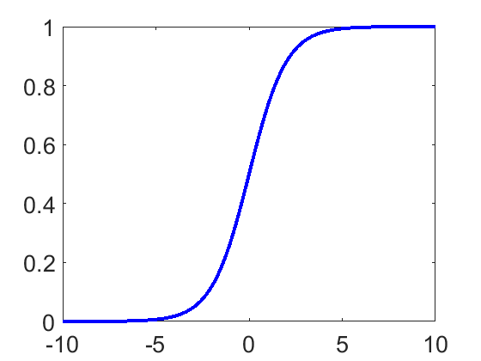
Supervised Learning
Logistic Regression Classifier
Unbalanced Sample
Under-sampling
Over-sampling
Evaluation
Training/Validation/Test: 5:2:3
 | TN | FN | TP | FP
Challenge | 85317 | 52 | 56 | 19
Current | 84961 | 16 | 92 | 375
 | Accuracy | Sensitivity | Specificity | Precision
Challenge | 0.99 | 0.52 | 0.99 | 0.75
Current | 0.99 | 0.85 | 0.99 | 0.20
 | Type I | Type II | F1 Score
Challenge | 0.25 | 6E-4 | 0.62
Current | 0.80 | 2E-4 | 0.32

Slide 8

Summary & Future Work
Progress
Credit card fraud problem has been investigated by machine learning methods
Statistic Approach F1 Score: 0.52
Supervised Learning F1 Score: 0.62
Future Work
More supervised learning algorithms
More statistic outlier detection method
Matlab to Python
Thank you !
Questions ?

